Slide 1
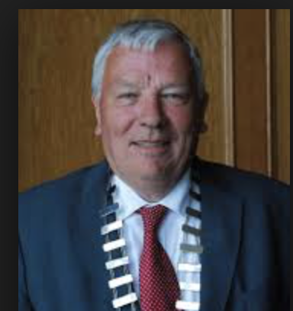
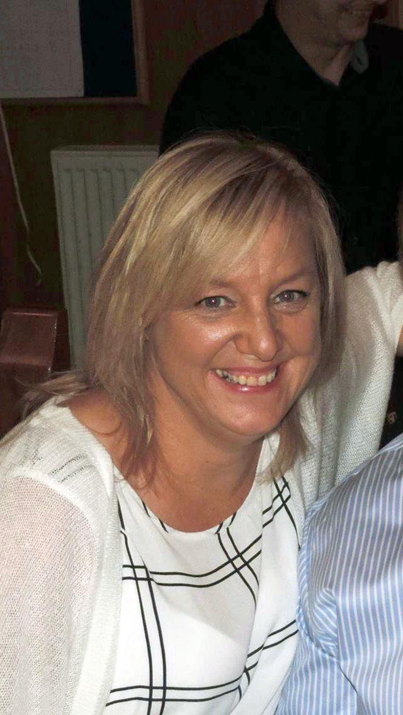
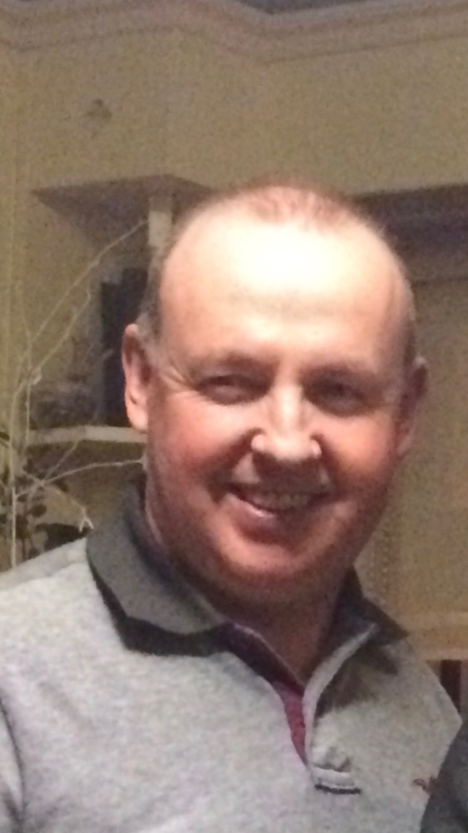
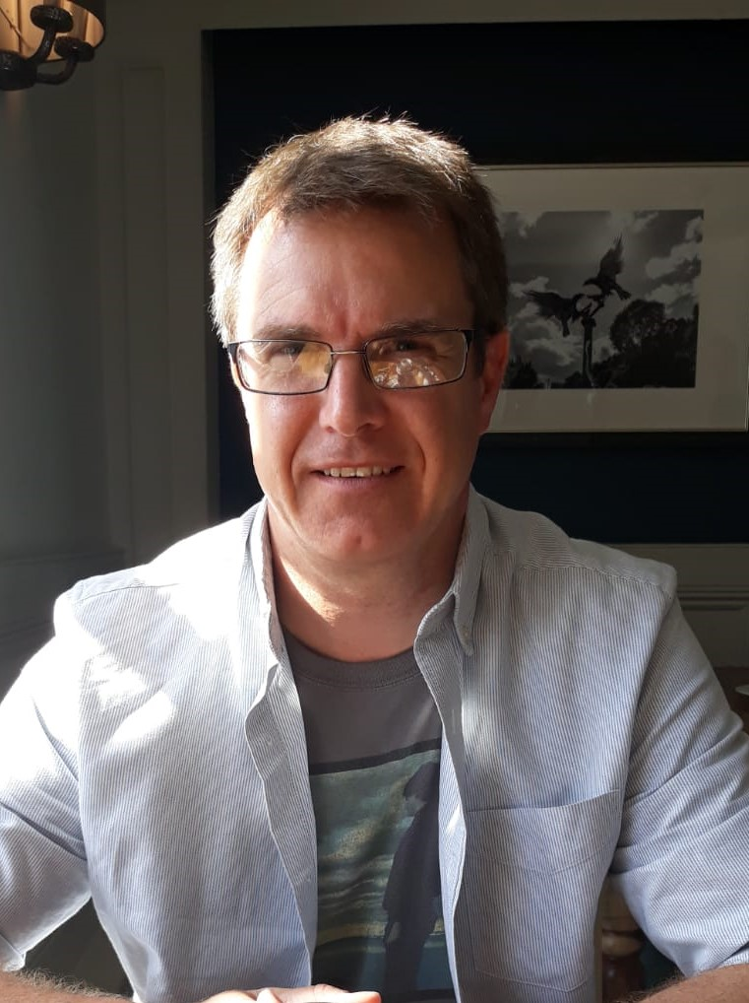
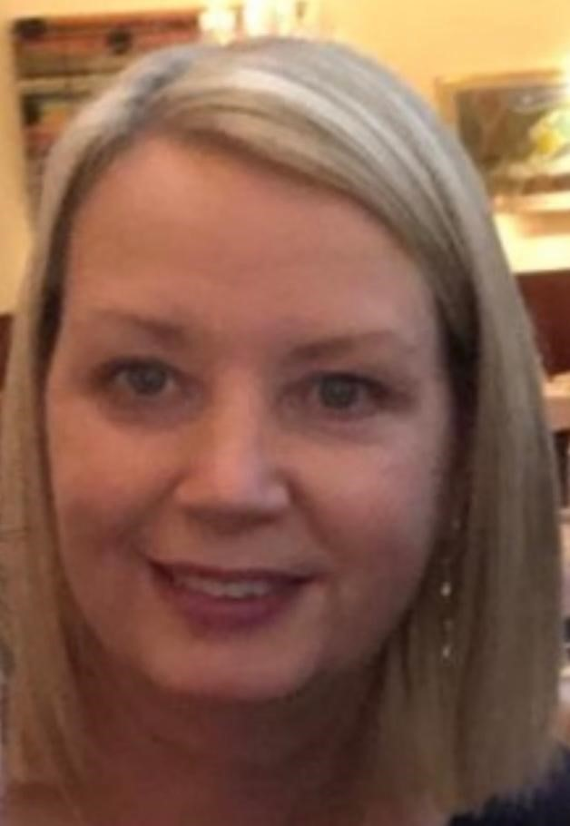
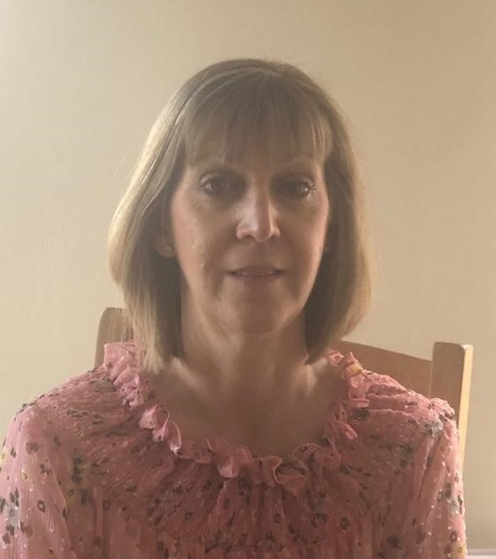
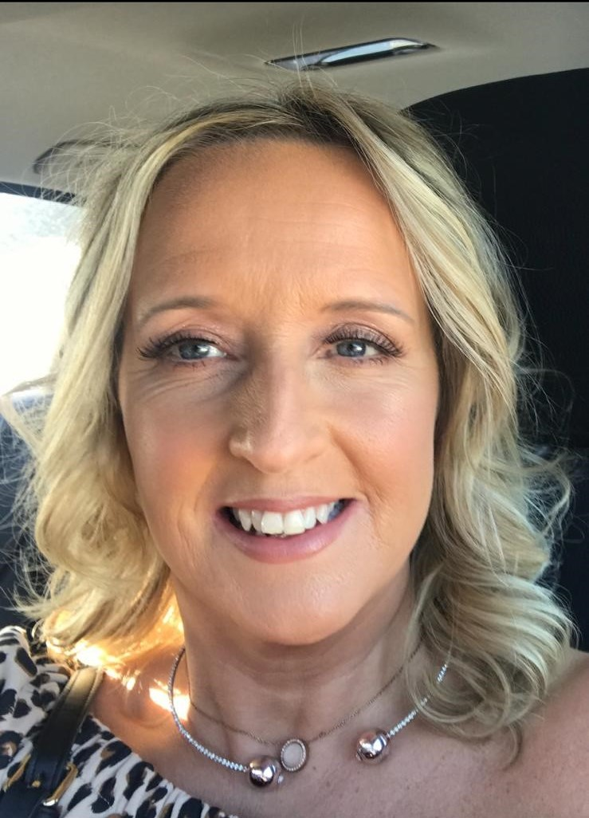
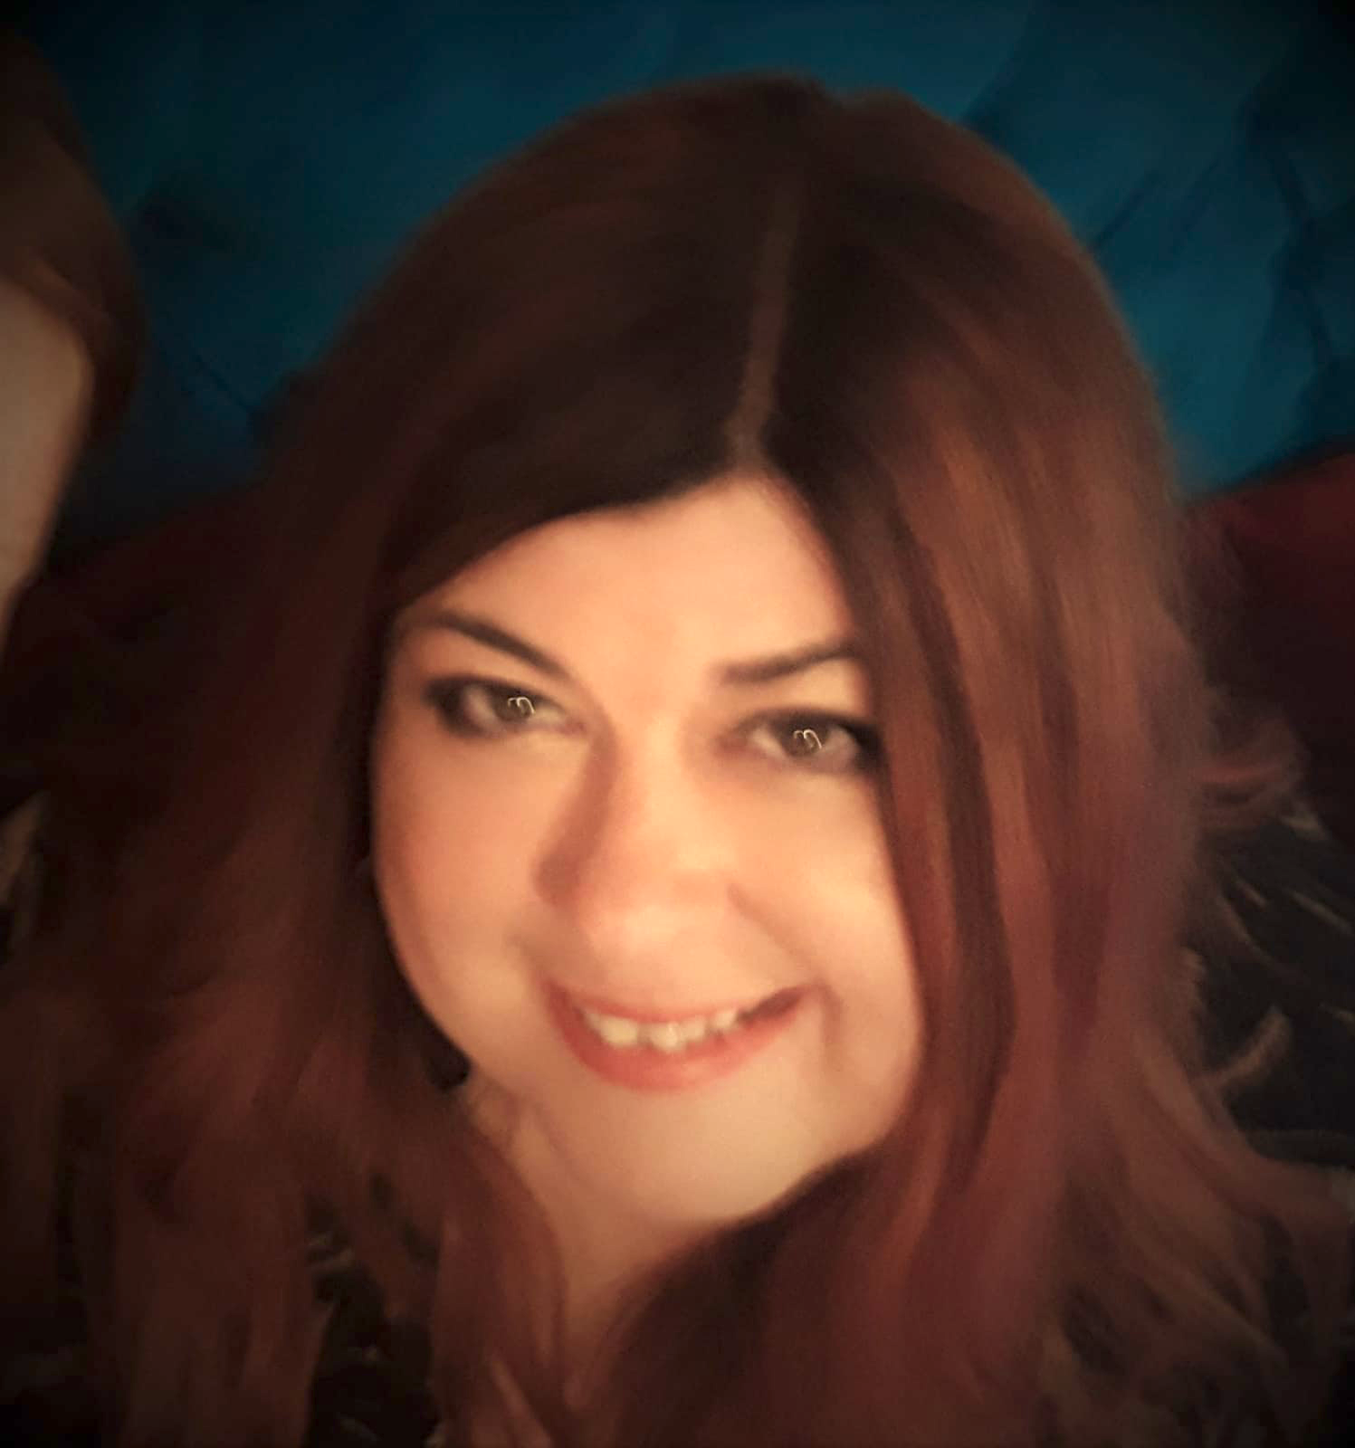
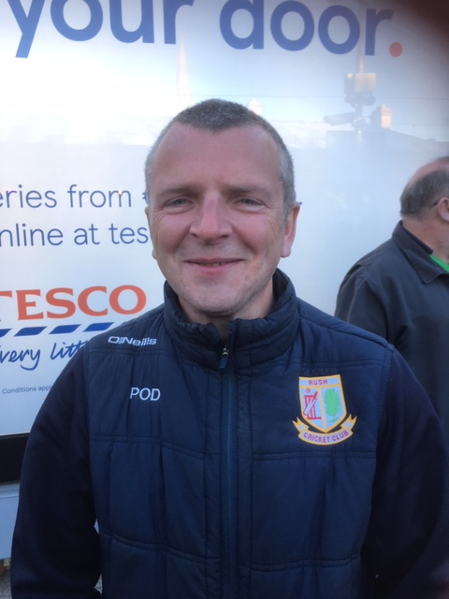
Rush Cricket Club - Safeguarding Personnel
Tony Sourke
Designated Liaison Person (DLP)
086 171 9577
Siobhan McBennett
Deputy DLP and Children’s Officer
087 261 2778
Caroline McGee
Children’s Officer
086 407 8836
Fergie McGee
Children’s Officer
086 242 6674
Mark Gough
Children’s Officer
086 782 4084
Nikki Gough
Children’s Officer
087 997 1123
Paul O’Donohoe
Children’s Officer
087 668 5452
Catherine Jones
Children’s Officer
087 901 2959
Audrey Farrell
Children’s Officer
087 280 0321
Lynne Carrick
Children’s Officer
087 653 2709

